Slide 1
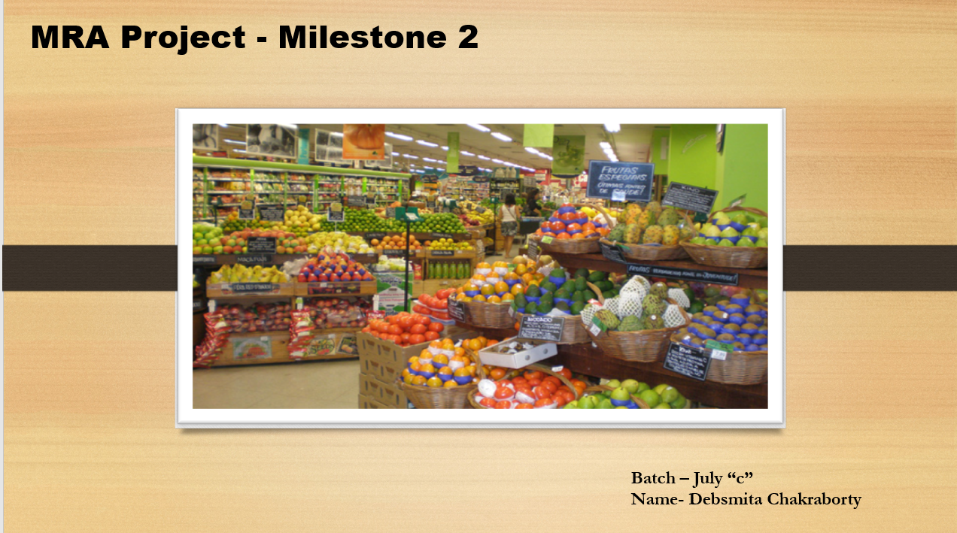

Slide 2
Table of Contents:
Problem Statement
Summary
Data Description and Analysis
Year wise Orders
Quarter wise Orders
Month wise Orders
Day wise Orders
Top and Bottom Products
Market Basket Analysis
Recommendations/Suggestions

Slide 3
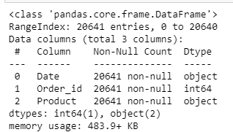
Problem Statement:
A Grocery Store shared the transactional data with us. Our job is to identify the most popular combos that can be suggested to the Grocery Store chain after a thorough analysis of the most commonly occurring sets of menu items in the customer orders. The Store doesn’t have any combo meals.
Data set :
Summary:
The data has different items with the date on which it was purchased and the order id. We have a total of 20641 rows and 3 columns. The data is of the below nature:

Slide 4
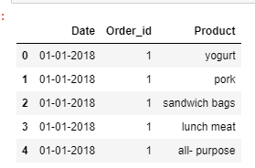
There are total 20641 row of data in the data set
There are total 3 feature in the data set-Order_ID, Date and Product.
There is no missing value.
There is no duplication.
Data Provided is from January to September for 2018 and 2019 and for January and February for 2020
The data heading is :
Currently there are 37 products sold namely:
poultry | juice | flour
soda | toilet paper | mixes
cereals | dinner rolls | all- purpose
ice cream | aluminum foil | dishwashing liquid/detergent
cheeses | coffee/tea | ketchup
waffles | shampoo | yogurt
soap | beef | individual meals
lunch meat | paper towels | tortillas
bagels | milk | pasta
eggs | butter | laundry detergent
hand soap | spaghetti sauce | fruits
sugar | sandwich bags | sandwich loaves
pork

Slide 5
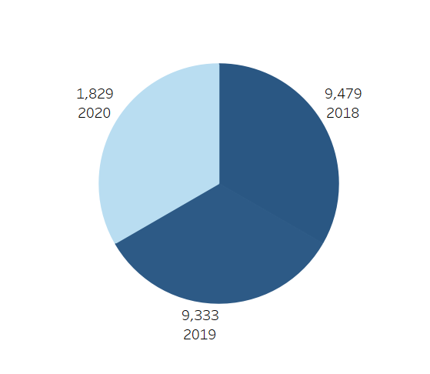
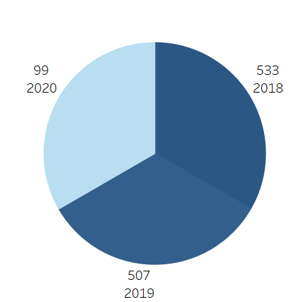
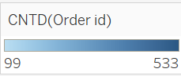
Data Description and Analysis:
Year Wise Orders:
Inference:
The maximum number of orders were in the year 2018 followed by 2019 and then 2020.
The first figure represents data for all counts irrespective of distinctions.
The second data represents count which are unique as per order number and date.
Since 2020 has data for only 2 months we see it has the lowest counts.

Slide 6
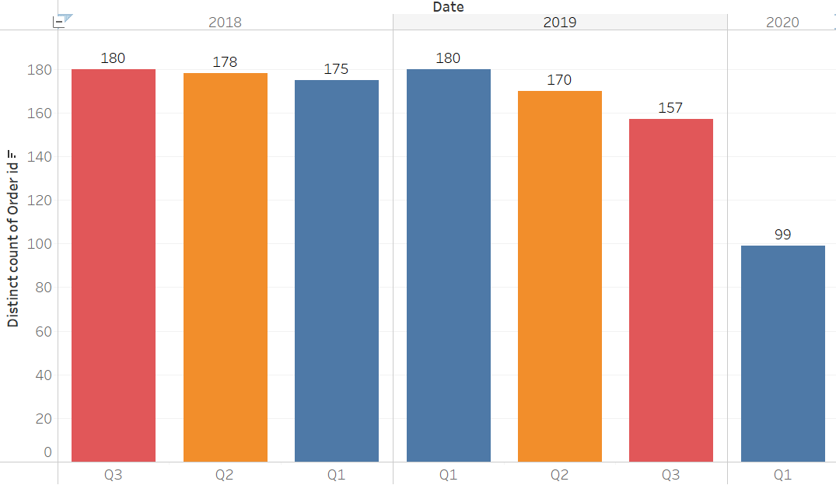
Quarter Wise orders:
Inference:
The highest sales is in 2018 and 2019 Quarter 1.
Going by the graph we can conclude that the order counts keep decreasing over the quarters as Q3 is lesser than Q2 and Q2 is less than Q1.

Slide 7
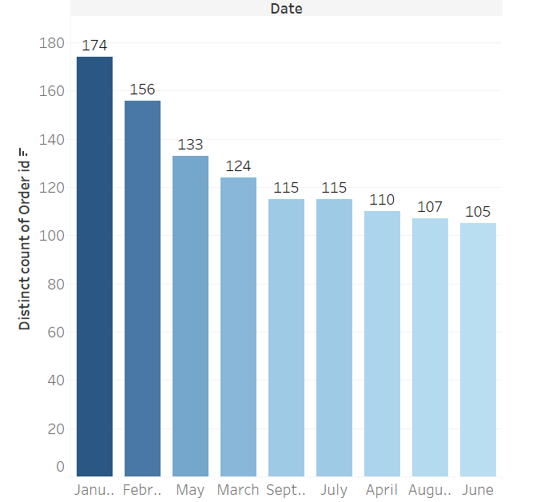
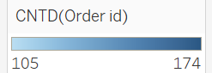
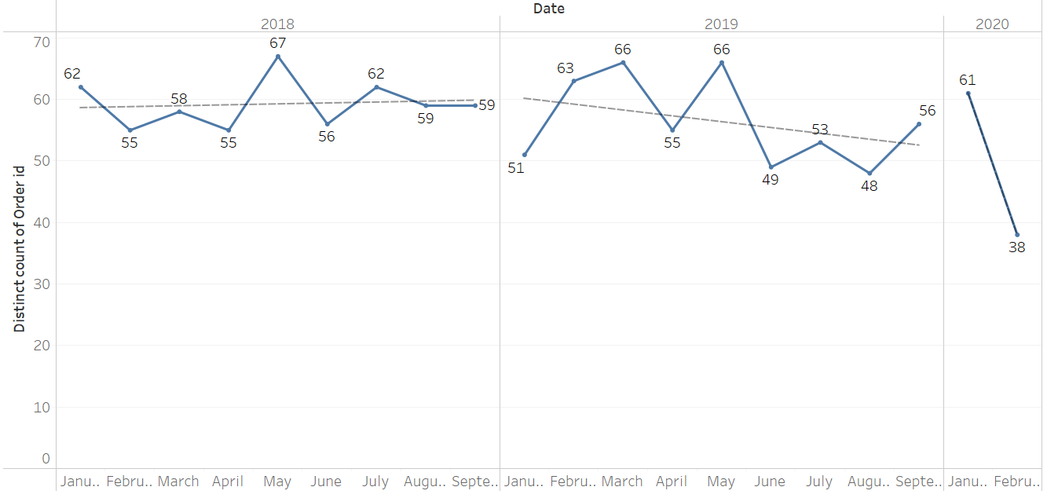
Highest orders month wise for all the years
Inference:
There is highest Number of transactions in January -174 and lowest number of records in June -154.
On average wise highest Number of orders are in May as January has 3 years of data and May has only 2 years of data.
The second figure shows the monthly division year wise where we see January to May has maximum sales over all the months.

Slide 8
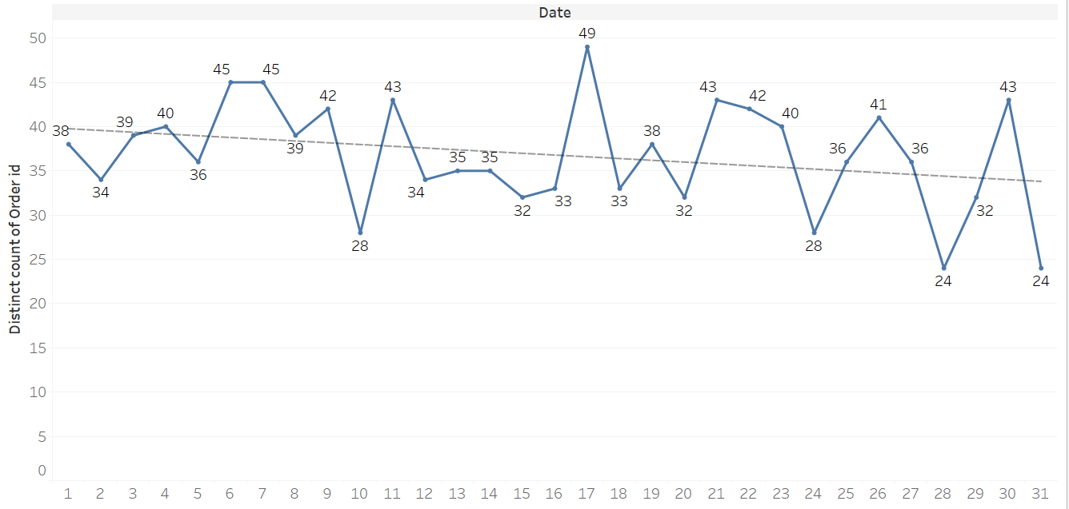
Day wise orders:
Inference:
Highest orders are around mid of the month.
We see orders dipping beyond normal in the 10th of every month and during the last 5 days of the month.

Slide 9
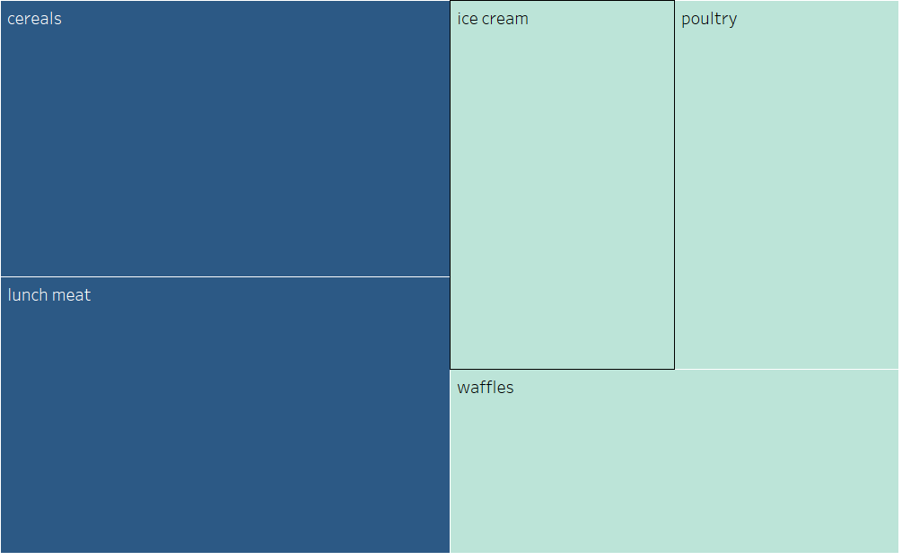
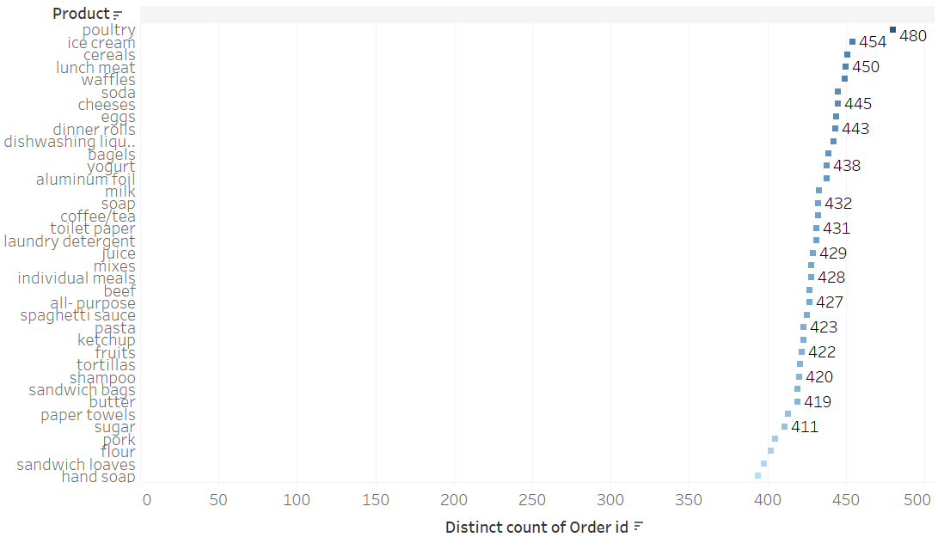
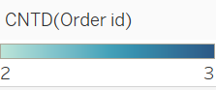
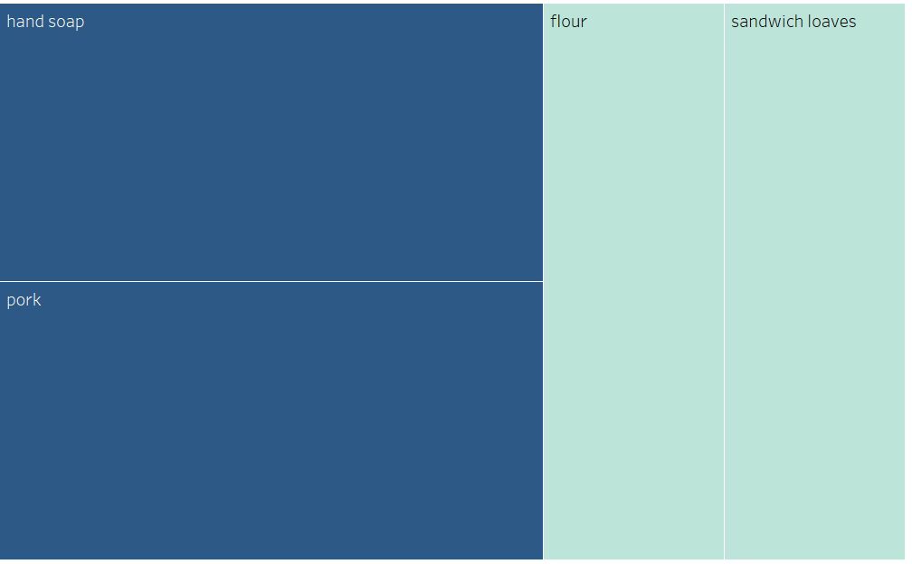
Product wise count of orders
Top 5
Bottom 5
Inference:
The product poultry is the order highest number of orders and hand shop is the lowest no of orders.
The top and bottom 5 products as per the highest and lowest number of orders placed is shown in the tree map.

Slide 10
Market Basket Analysis
Market Basket Analysis is a technique which identifies the strength of association between pairs of products purchased together and identify patterns of co-occurrence. A co- occurrence is when two or more things take place together.
Market Basket Analysis creates If-Then scenario rules, for example, if item A is purchased then item B is likely to be purchased. The rules are probabilistic in nature or, in other words, they are derived from the frequencies of co-occurrence in the observations. Frequency is the proportion of baskets that contain the items of interest. The rules can be used in pricing strategies, product placement, and various types of cross-selling strategies.
In order to make it easier to understand, think of Market Basket Analysis in terms of shopping at a supermarket. Market Basket Analysis takes data at transaction level, which lists all items bought by a customer in a single purchase. The technique determines relationships of what products were purchased with which other product(s). These relationships are then used to build profiles containing If-Then rules of the items purchased. The rules could be written as If {A} Then {B}.
The If part of the rule (the {A} above) is known as the antecedent and the THEN part of the rule is known as the consequent (the {B} above).
The antecedent is the condition and the consequent is the result. The association rule has three measures that express the degree of confidence in the rule, Support, Confidence, and Lift.

Slide 11
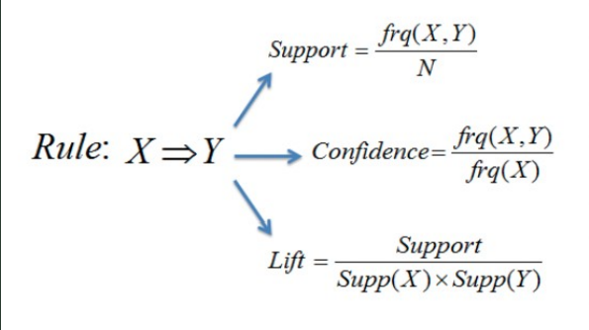
Support: Its the default popularity of an item. In mathematical terms, the support of item A is nothing but the ratio of transactions involving A to the total number of transactions.
Confidence: Likelihood that customer who bought both A and B. Its divides the number of transactions involving both A and B by the number of transactions involving B.
Lift : Increase in the sale of A when you sell B

Slide 12
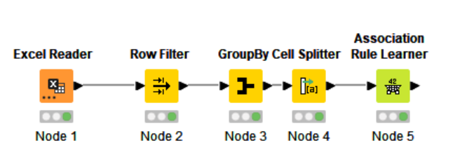
Why MBA here?
The idea is to know which products when combined together probably will increase orders which is what Market Basket helps in. It is like conditional probability which helps us know the probable commodities if combined provided customer already purchased certain things will purchase the basket we make. The customer will get a proper combination which probably will increase our orders as it is based on the data of the pattern of the customer.
KNIME flow
Inference:
Excel Reader- Reads the file
Row filter- Remove all-purpose as it was a generic field not giving clarity on exactly which all products.
Group By- We have group the data as per the products.
Cell-Splitter- Converted product data to set.
Association Rule Learner- Combination of products by Market Basket Analysis method. Most Frequent combinations purchased

Slide 13
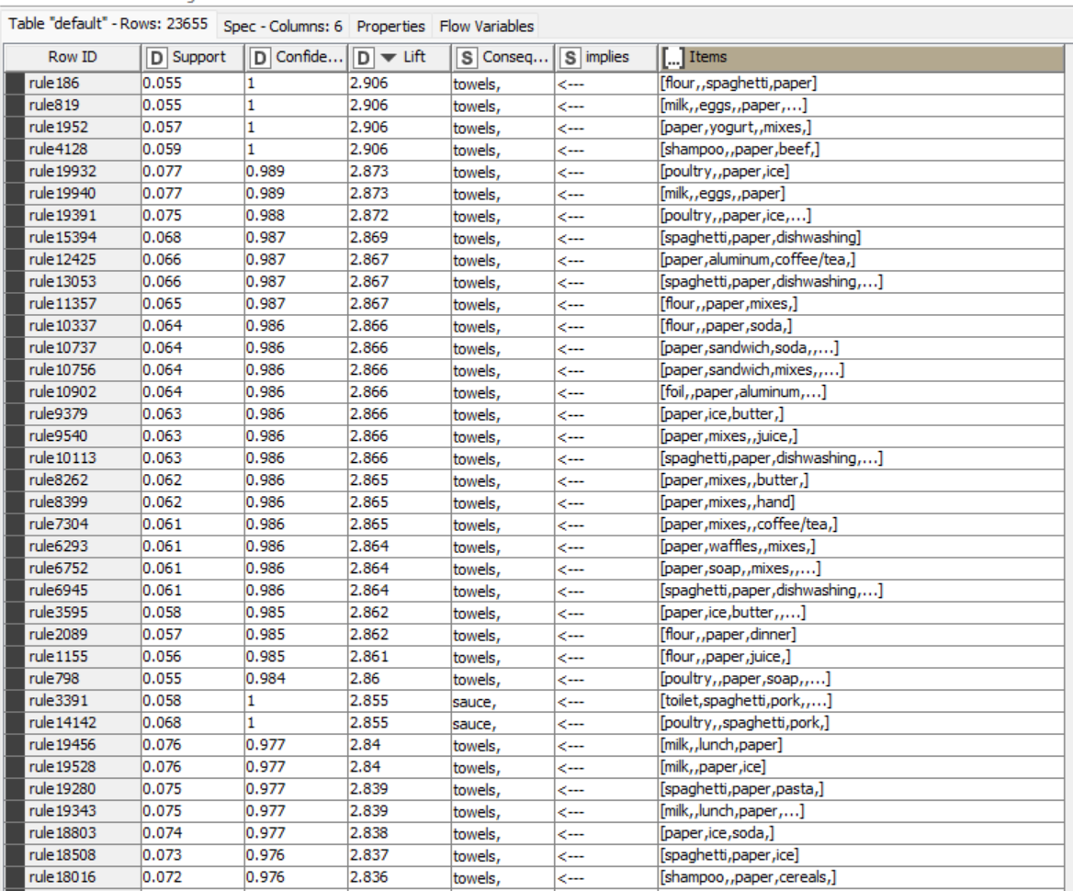
Association in a tabular manner
Inference:
A lift of 1, it would imply that the probability of occurrence of the antecedent and that of the consequent are independent of each other.
Support is an indication of how frequently the items appear in the data. The minimum support here has been taken as 0.055 since data is not that sufficient to guess.
Confidence indicates the number of times the if-then statements are found true. Confidence is at 70%.
All items with an uplift of one can be clubbed together.
All items above 1 uplift value can be clubbed together.

Slide 14
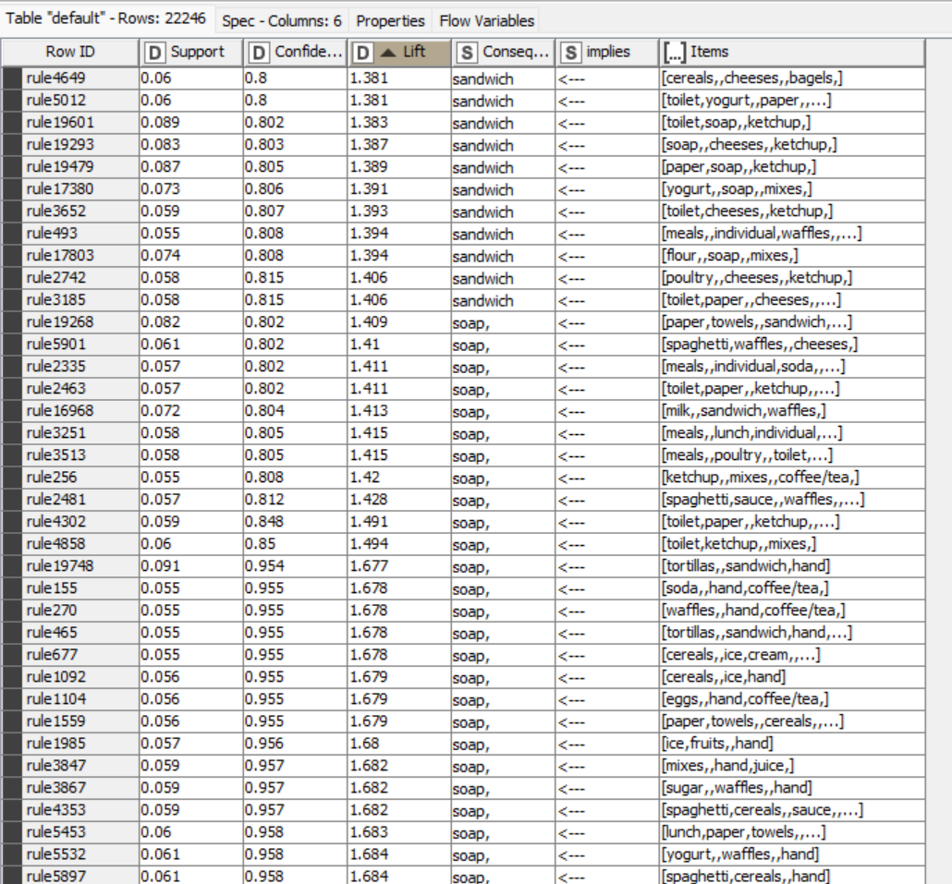
Inference of Market Basket Result
So as we can see in the previous slide the table shows 23655 records in which each row contains a different rules.
It has created multiple rules on the basis of threshold limit that we have set earlier in the Association Rule Learner Node and whichever has a higher lift value we recommend that product to the customer.
Consequent column contains recommended products and we have sorted the lift values from higher to lower for the better recommendations.
So generally we recommend the products that are listed in consequent feature which has a higher lift value.
That means it has the higher probability of being purchased by the customer.
Low lift is as below:

Slide 15
Recommendation/Suggestions
Since 10th of the month and end of the month have least sales more offers and discounts can be given at this period. Starting of the month should have more profit margin as orders are high during that time.
More combo offers can be given to customers during month end to get customer loyalty.
Since flour, spaghetti and paper have best combinations and cereals, cheeses and bagels have the least a combo offer can be given here. A combo of flour with cereals or spaghetti with cheese will be the best ones.
Towels can be given as free gift on purchase of certain amount of paper. Making sure quality of the towel is good. Once customers get used to the product towels can be charged and treated separately for orders.
Highest orders were received for poultry so cheese and poultry can have combo or discounted offers. A minimum of 10% discount can be given.
Month of January has the maximum orders so more concentration on poultry, ice cream, cereals, lunch meat, waffles, soda, cheeses and eggs in March 2020 to get more orders.
Since hand soaps are least ordered we can give them free with liquid dishwasher. A trial pack soap of not more than 2% of the price of the liquid dishwasher to maintain profit margin.
We can have one free tasting of juices and coffee tea to attract more orders in that area.

Slide 16
Tools used:
Python - Attached in the portal
Tableau - https://public.tableau.com/views/Debsmita_MRA2/Top5products2?:language=en-US&publish=yes&:display_count=n&:origin=viz_share_link
THANKYOU

